Slide 1


DEPARTMENT OF INFORMATION SCIENCE & ENGINEERING
“IDENTIFICATION OF CRIME PRONE AREAS”
COURSE NAME : MINI PROJECT
COURSE CODE: 20ISE391A
PRESENTATION BY:
1.ROHAN NAGARKATTE [1NH20IS134]
2.MOHAMED KHALID [1NH20IS080]
3.KAMBOJI AKHILESH [1NH20IS070]
4.LOKESH PRASAD [1NH20IS078]
UNDER THE GUIDANCE OF ,
GUIDE NAME: MRS. BILVIKA
DESIGNATION: PYTHON LECTURER

Slide 2

AGENDA
Introduction
Literature survey / Existing system
Limitations of Existing System
Problem Definition
Proposed system
Objectives
Design modules
Algorithm / Flow chart
Conclusion

Slide 3

INTRODUCTION
Crime cannot be predicted since it is neither systematic nor random.
Even though we cannot predict who all may be the victims of crime but can predict the place that has its occurrence. The results shows that our application helps in reducing crime rate to a certain extent by providing security in crime prone areas.
So for building such a powerful crime analytical tool we have to collect crime records and evaluate it.

Slide 4

LITERATURE SURVEY / EXISTING SYSTEMS
DATA CRIME APPROACHES TO CRIMINAL CAREER ANALYSIS
Published by: IEEE. Paper Summary: Narrative reports and criminal records are stored digitally across individual police departments. Augmenting the traditional, more socially oriented, approach of behavioral study of these criminals and traditional statistics, data mining methods like clustering and prediction enable police forces to get a clearer picture of criminal careers. This method yields a visual clustering of these criminal careers and enables the identification of classes of criminals.

Slide 5

LIMITATIONS OF EXISTING SYSTEMS
Current policing strategies does not allow to proactively review and plan suitable resource deployments and patrolling in those areas.
But, with the help of technological advancement, we can use historic crime data to recognize crime patterns and use these patterns to predict crimes beforehand.

Slide 6

PROBLEM DEFINITION
To analyze sample historic data from emergency services and to build a solution for predictive policing that is able to identify areas where crimes are more likely to occur.

Slide 7

OBJECTIVES
To have an automated system to continually identify areas that are more prone to crimes and policing-related incidents, than others.
This would allow to preempt and prevent, as far as possible, untoward incidents that could result in an emergency.

Slide 8

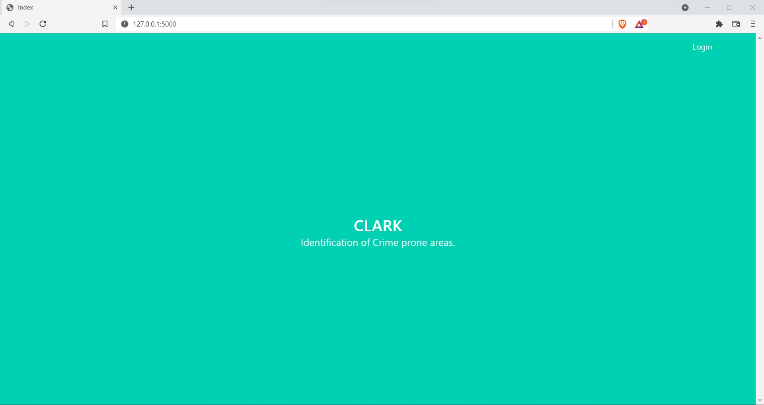
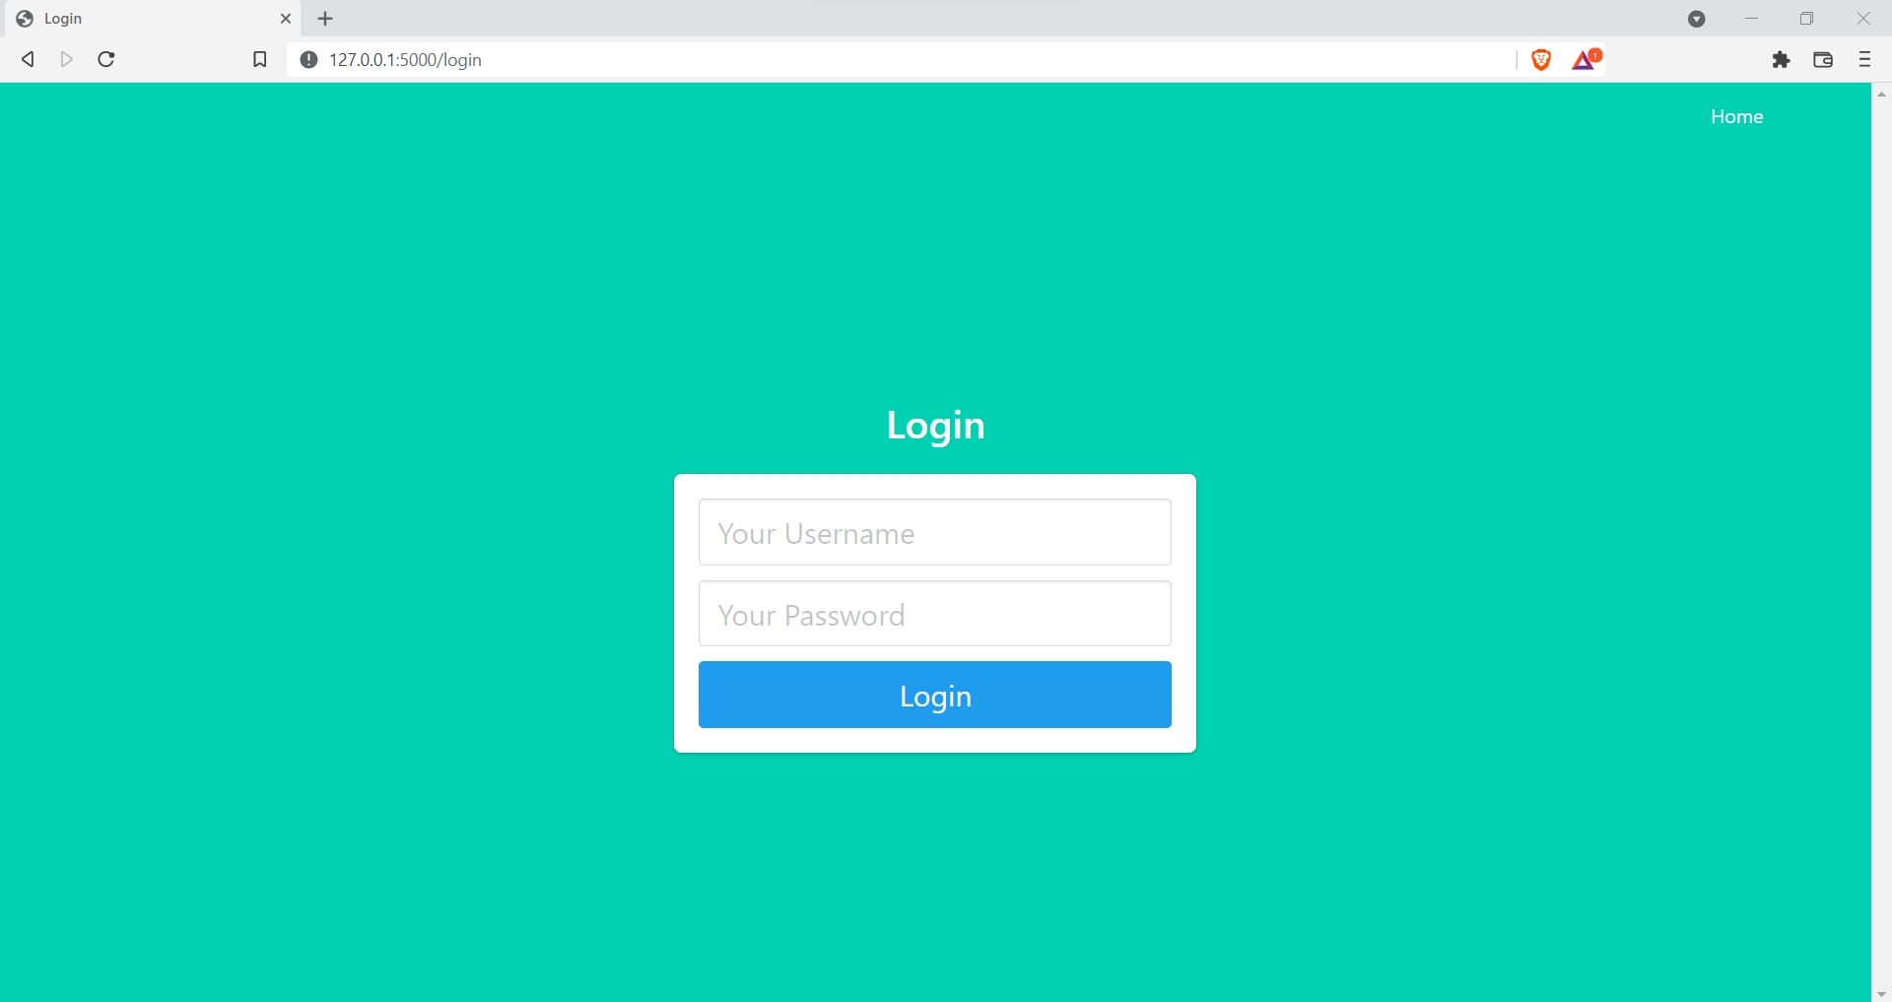
DESIGN MODULES-1
Entry Page
Login Page

Slide 9


DESIGN MODULES-2
Welcome Page
Update Page

Slide 10
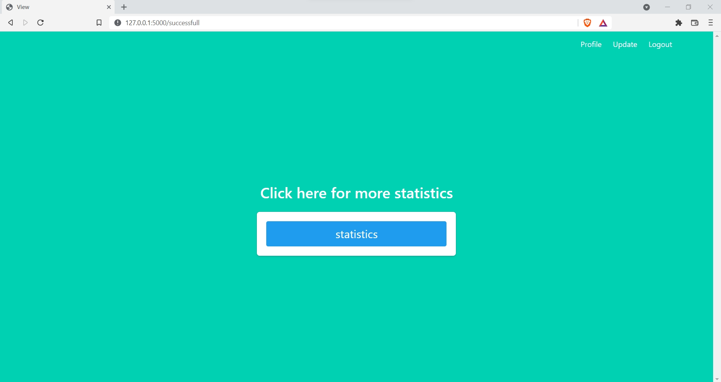
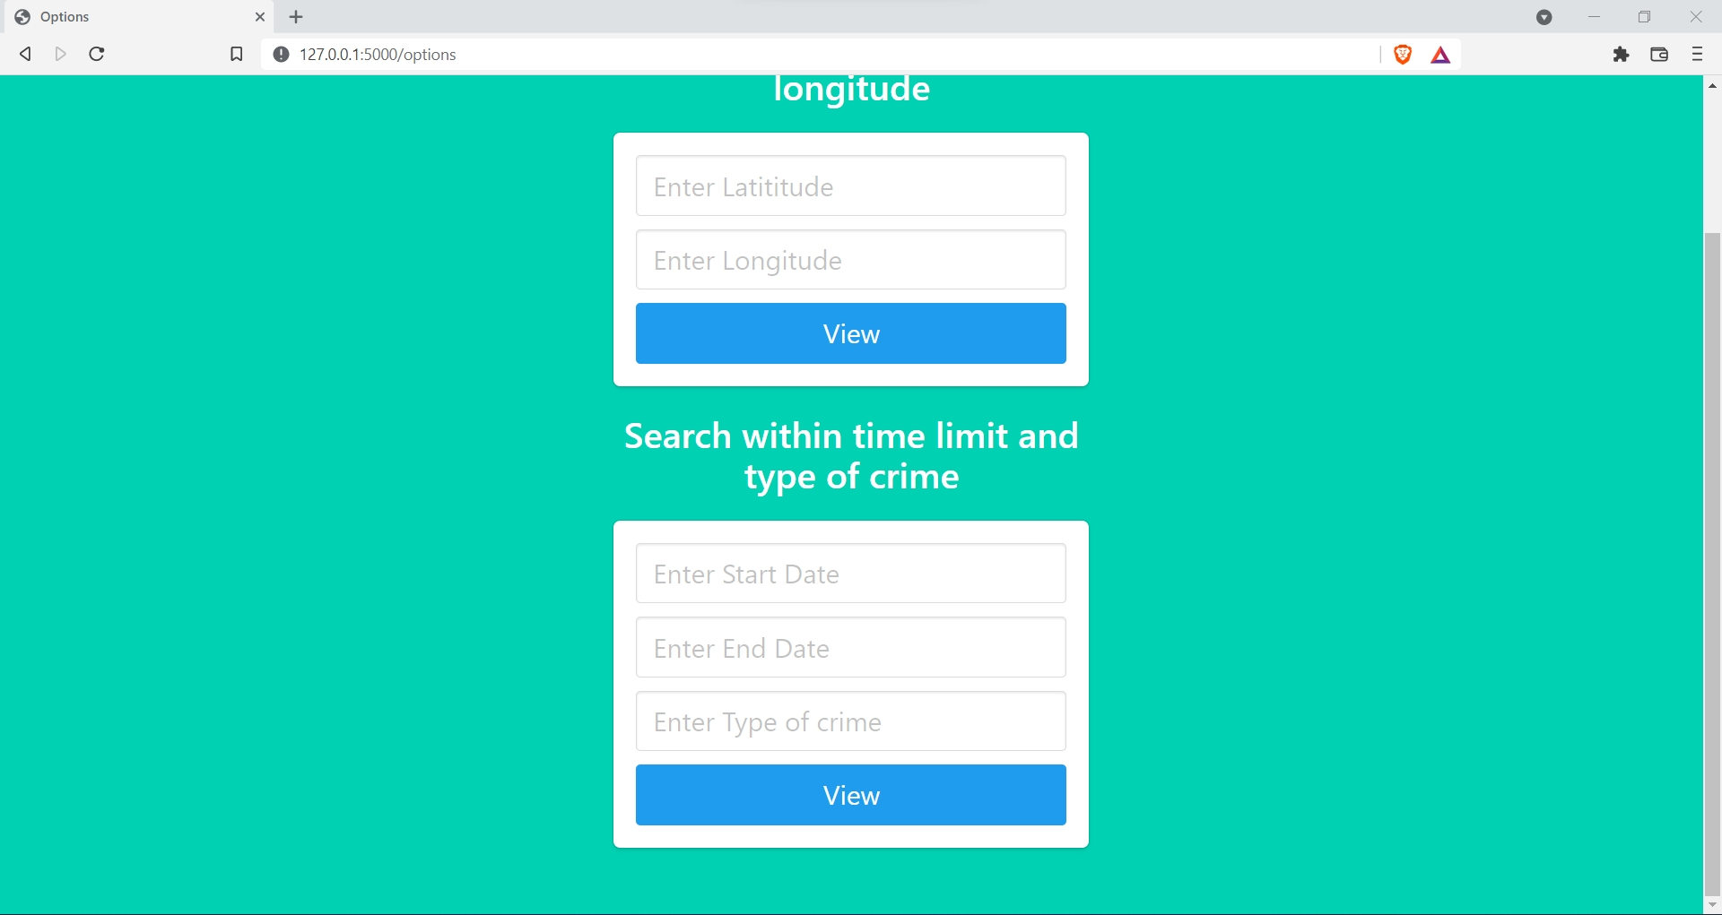
DESIGN MODULES-3
Statistics Page
Option Entry Page

Slide 11
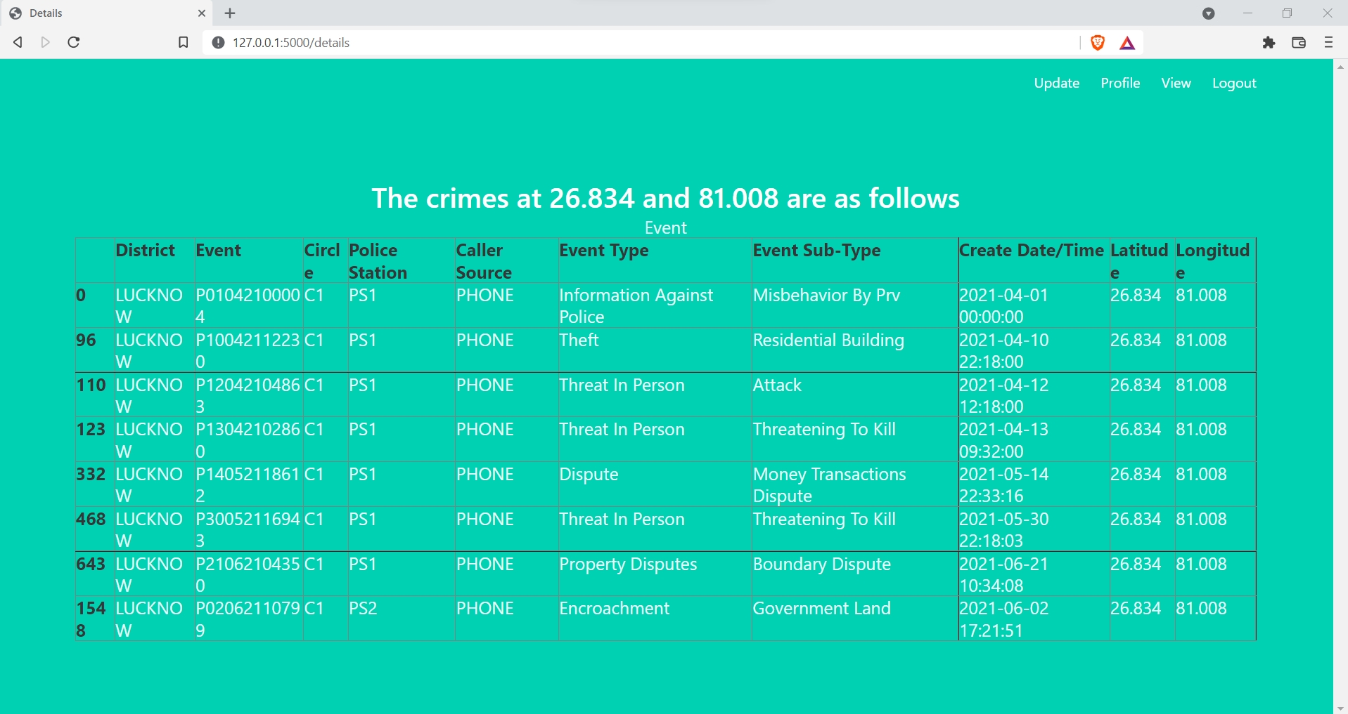
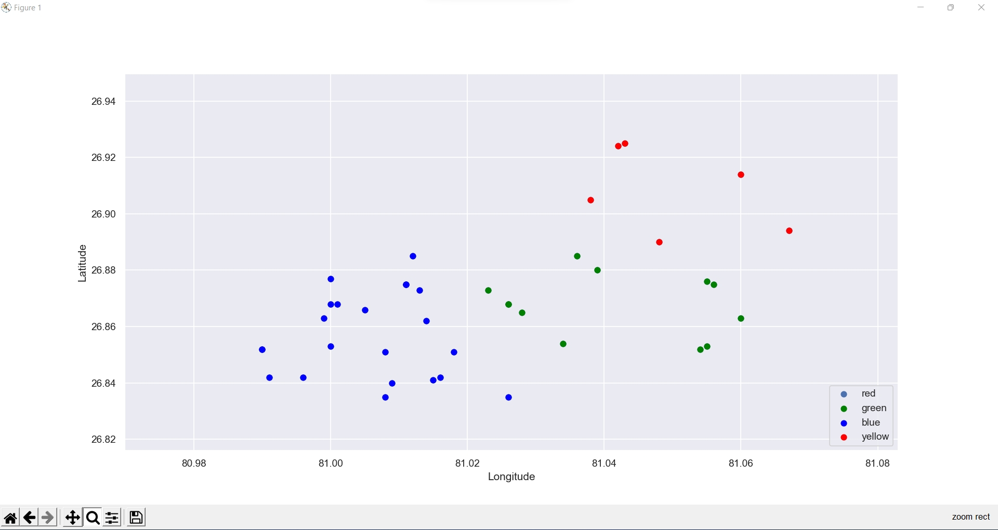
DESIGN MODULES-4
Details Page
Graph Results Page

Slide 12

FLOWCHART
Dataset Input
Data Preprocessing
Applying Clustering Algorithm
Crime Detection
Crime Classification
Pictorial Representation
Prediction by Statistical Analysis

Slide 13
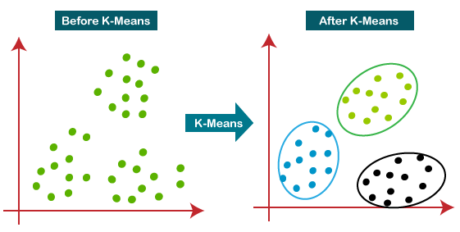
ALGORITHM
K-Means Clustering is an Unsupervised Learning algorithm, which groups the unlabeled dataset into different clusters. Here K defines the number of pre-defined clusters that need to be created in the process, as if K=2, there will be two clusters, and for K=3, there will be three clusters, and so on.

Slide 14
STEPS OF K MEANS ALGORITHM
The working of the K-Means algorithm is explained in the below steps:
Step-1: Select the number K to decide the number of clusters.
Step-2: Select random K points or centroids. (It can be other from the input dataset).
Step-3: Assign each data point to their closest centroid, which will form the predefined K clusters.
Step-4: Calculate the variance and place a new centroid of each cluster.
Step-5: Repeat the third steps, which means reassign each datapoint to the new closest centroid of each cluster.
Step-6: If any reassignment occurs, then go to step-4 else go to FINISH.
Step-7: The model is ready.

Slide 15

CONCLUSION
Our system takes elements attributes of an area and preprocessing offers the frequent patterns of that place.
We trained the system based on some particular inputs so that machine automatically learns the converting patterns in crime through examining the crime patterns.
For getting better results in prediction we are planning to include more factors to improve accuracy and we are also planning to represent it in user friendly representation.

Slide 16

REFERENCES
Data Analytics using Python by Bharti Motwani
CSS and HTML Web Design by Craig Grannell
Data Clustering: Algorithms and Applications by Charu C Aggarwal
Building Web Apps with Python and Flask

Slide 17

THANK YOU

